Slide 1
SASGSUB Macros SAS Grid Manager Client Utility
David Glemaker
Principal Technical Architect
SAS Health Analytics Practice

Slide 2
SASGSUB Macros
Agenda
Why submit SASGSUB from SAS® Enterprise Guide®
Calling SASGSUB Macros in SAS® Enterprise Guide®
Admin Grid macros
Setup for SASGSUB Macros

Slide 3
SASGSUB Macros
Why Submit gsub from SAS® Enterprise Guide®
Submit and forget (disconnect EGuide or from the network)
Frees up EGuide session
No client Install and config of LSF and SASGSUB (everything stays on the server)
No need for shared file access between compute and client tier
No need for WinSSH and keys setup for each user for staging when Unix Server is SSH
Single client application access to SAS Grid (user only needs EGuide, no need to change interfaces to submit to SASGSUB)
Customers also like to submit these macros from SAS Studio and DMS
Disclaimer: These are not production macros delivered with SAS software, however, they are leveraging BASE SAS code. They have been tested on RHEL and might need slight changes for different O/S, versions, or shells. They have been implemented successfully at customers running on RHEL, Solaris, AIX and Windows.

Slide 4
SASGSUB Macros
Macros for the SAS User Role
Submitting gsub with EGuide
%mygsub %mygsubnight %mygsubpri
%gjobs and %gsstatus – reports on job status
%gsresults – move job results to a different directory
%gskill – terminate a gsub job
Macros for the SAS Admin role
%gjobsall – reports on job status of all users
%bhosts – reports on Grid node status and number of jobs by machine
%bqueues - reports on queue priority, status, and number of jobs by queue
%lsload, %lsloadl, %lshosts – reports on Grid node resources
%bacct and %bacctq – reports Grid history by user and/or queue
%egoshl and %egoshv – reports EGO service list and individual services information
Notes:
%mygsub, %gsstatus, and %gsresults require the setup steps in later slides to set the &gsconfigdir macro variable.
All Grid macros require xcmd to be enabled.
These are the main Grid macros users will use, lets discuss each on the next slides.
All macros have a simpler version where its name preceeds with an “s” i.e. %gjobs to %sgjobs. Thanks to Patrick Curren these have been added for ease of testing and tweaking as well as usage.

Slide 5
SASGSUB Macros
Submitting SASgsub with EGuide
%mygsub (/shared/apgm/sleep1.sas);
%mygsubnight (/shared/apgm/sleep1.sas);
%mygsubpri (/shared/apgm/sleep1.sas);
Macro call for batch submission of gsub
SAS program residing on shared file system

Slide 6
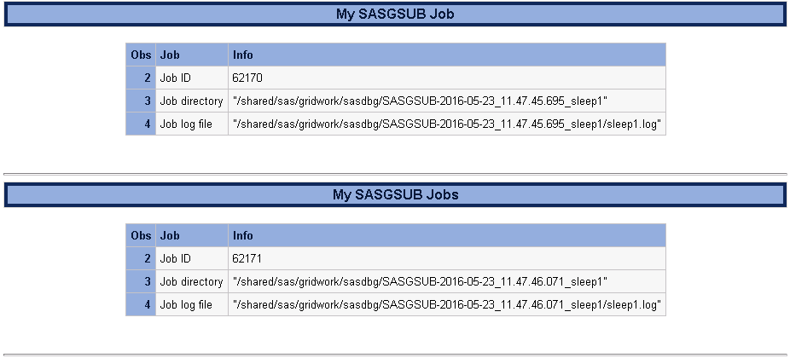
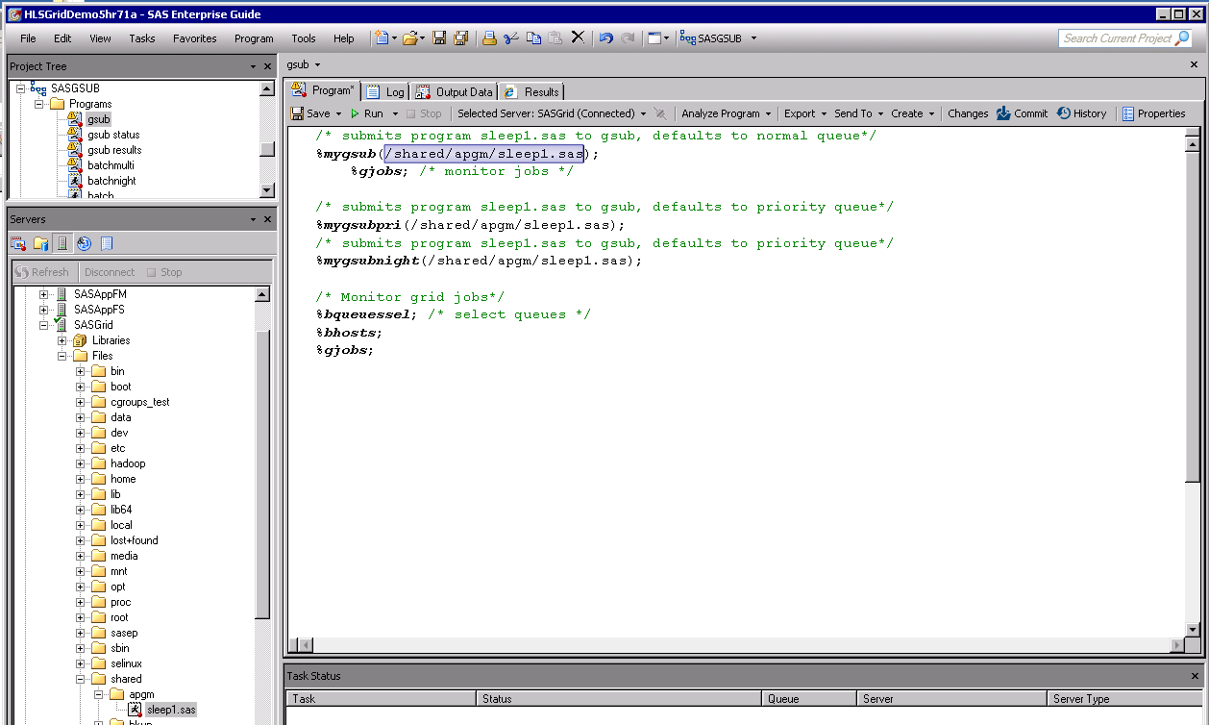
Submitting SASgsub with EGuide
Notes:
%mygsub results give jobid, job directory and job log. This example is the default locations of sasgsub to the Gridwork directory.

Slide 7
SASGSUB Macros
Grid Monitoring with EGuide
%gjobs;
Macro call for monitoring Grid jobs
Notes:
%gjobs show all Grid jobs for the user.

Slide 8
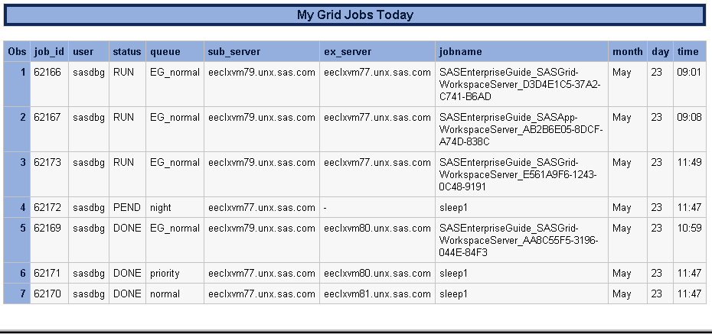
Grid Monitoring with EGuide
Notes:
%gjobs show all Grid jobs for the user including Grid launched sessions like EGuide, AMO, EM, DI, FS, etc.
Notice the job from mygsubnight is Pending while the others have already run and have a status of DONE and EGuide sessions are in status of RUN as expected

Slide 9
SASGSUB Macros
Grid Monitoring gsub jobs with EGuide
/* provide jobid for individual job or “all” for all gsub jobs */
%gsstatus(jobid=all);
Macro call for monitoring status of gsub jobs
Notes:
%gsstatus is designed to only show sasgsub jobs submitted not other Grid sessions like EGuide, DI, etc.
Show status for a specific jobid or “all” for all gsub jobs. “all” is the default if you just submit %gsstatus

Slide 10
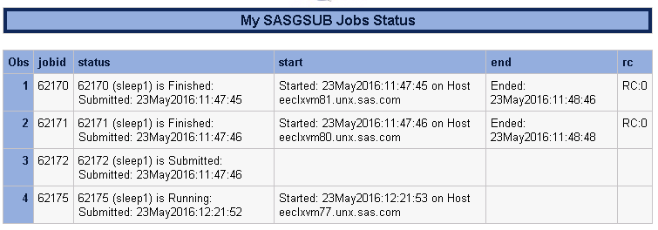
Finished
Pending
Night queue
Running
Notes:
%gsstatus is designed to only show sasgsub jobs submitted not other Grid sessions like EGuide, DI, etc.
Notice only the gsub jobs appear this time unlike the %gjobs.
This example also shows the results of jobs at various status
RC:0 means no errors

Slide 11
gsub Macros
Get results option for gsub
/* individual jobid or all */
%gsresults(jobid=all, mydir=/home/sasdbg);
Macro call for moving results/job directory of gsub jobs
Provide jobid for an individual job or “all” for all jobs (all is the default)
Provide new location to move results (must exist on shared file system)
Notes:
%gsresults is designed for users to move results/job directory to more suitable location than the default Gridwork directory.

Slide 12
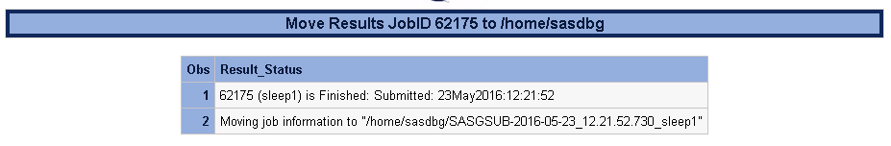
Get results option for gsub
Notes:
%gsresults is designed for users to move results/job directory to more suitable location than the default Gridwork directory.

Slide 13
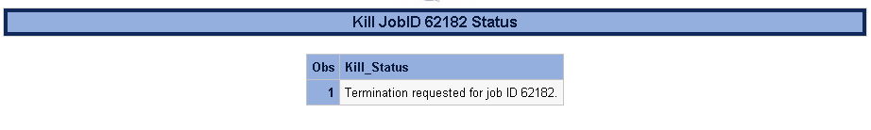
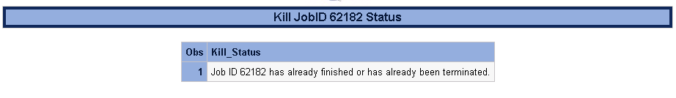
SASGSUB Macros
Killing gsub jobs with EGuide
/* provide jobid for individual job */
%gskill(jobid=1234);
Macro call for killing gsub job
Use %bkill(jobid=<jobidnum>) instead of %gskill for non gsub jobs (i.e. EG jobs, SAS Studio jobs, rsubmit jobs, etc)
Notes:
%gskill is designed to kill your gsub job.

Slide 14
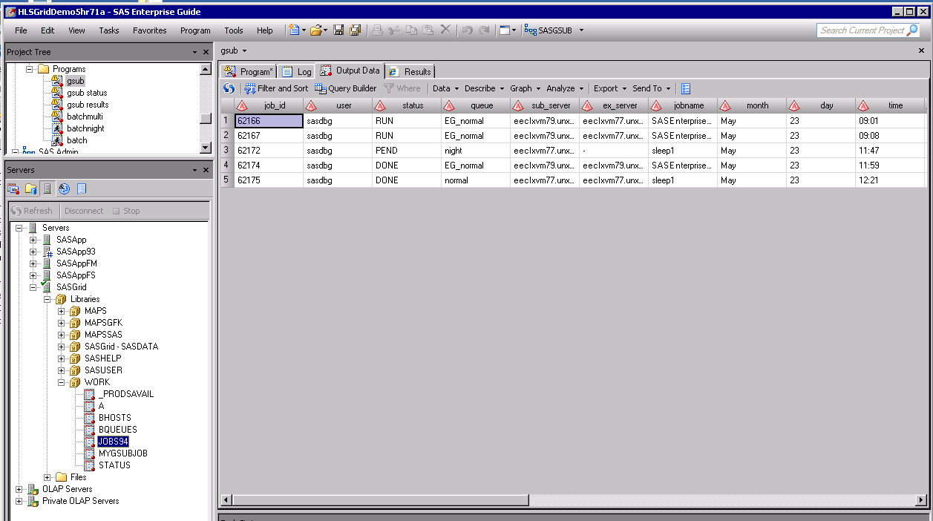
Notes:
Note these macros also create saswork tables for other uses if you need them.

Slide 15
SASGSUB Macros - Easily Customizable
%macro mygsub(mypgm);
options spool;
filename results pipe "&gsconfigdir./sasgsub -Gridsubmitpgm &mypgm";
data mygsubjob;
infile results dlm=":" missover truncover;
length Job $200. Info $200. info2 $200. ;
input Job Info Info2;
if substr(job,1,1) not in ("J") then delete;
if substr(info2,1,1) not in (" ") then info=compress(info)||":"||compress(info2);
run;
title "My SASgsub Job";
proc print data=mygsubjob; where info ne " ";
var job info;
run;
options nospool;
%mend mygsub;
Notes:
These macros are easily customizable for most SAS programmers. Edit the command in the filename statement and any parsing in the data step.

Slide 16
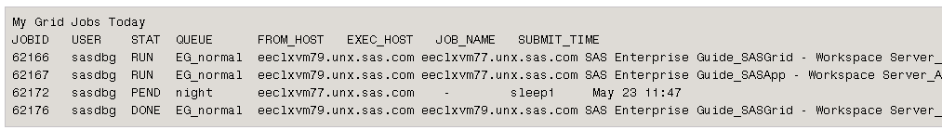
SASGSUB Macros - Easily Customizable
%macro smygsub(mypgm=, que=normal);
options linesize=max ;
filename cmdout pipe "&gsconfigdir./sasgsub -Gridsubmitpgm &mypgm -Gridjobopts queue=&que" LRECL=2000;
data _null_ ;
infile cmdout;
input;
file print notitles;
if _n_ = 1 then put "My SASgsub Job";
put _infile_;
run;
%mend smygsub;
Tradeoff:
Outputs are not as pretty and no SAS Tables
Notes:
If the main macros seem too hard to customize then Patrick Curren wrote simple versions of each macro. You will find them with the same name except with preceeded with an “s”. i.e. %mygsub to %smygsub. Justs edit the command in the filename stmt. Note this one has added the queue option. Also output is just flat file output. Also not no output tables, so no parsing of results needed.

Slide 17
SASGSUB Macros
Submitting SASgsub with EGuide
SAS Admin Role Grid Macros
%gjobsall;
Macro call for monitoring Grid jobs for all users
Notes:
%gjobsall show all Grid jobs.

Slide 18
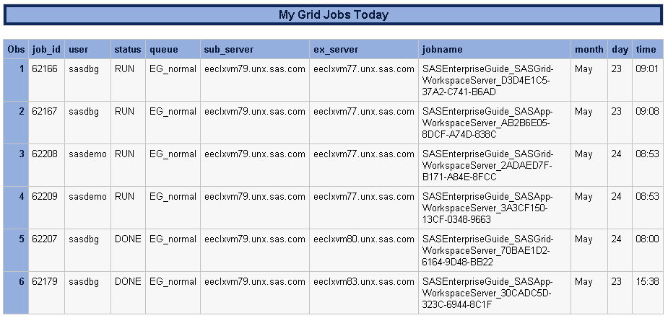
Notes:
%gjobsall shows all Grid jobs including Grid launched sessions like EGuide, AMO, EM, DI, FS, etc.

Slide 19
SASGSUB - SAS Admin Role Grid Macros
%bhosts;
Macro call for monitoring Grid servers
Notes:
%bhosts shows all Grid nodes status and number of jobs

Slide 20
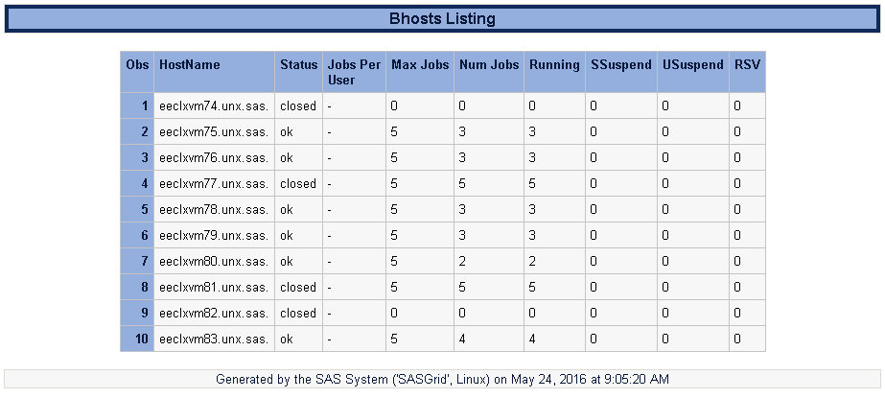
Notes:
%bhosts shows all Grid nodes status and number of jobs
Notice we have set max job slots to 0 on the the master, so it is in closed status, while other nodes are in closed status due to having 5 jobs running which meets their max job limit.

Slide 21
SASGSUB - SAS Admin Role Grid Macros
%bqueues;
Macro call for monitoring Grid queues
Notes:
%bqueues shows all Grid queues status and number of jobs

Slide 22
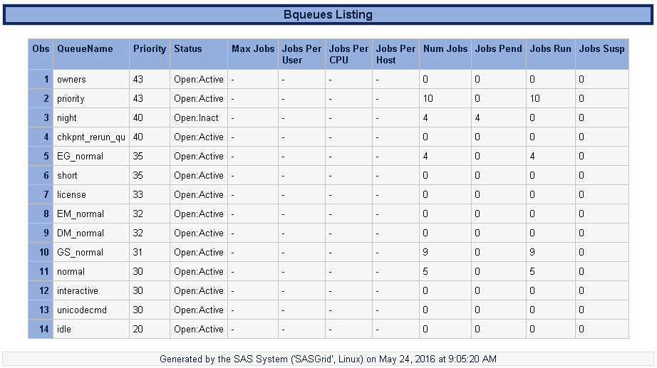
Notes:
%bqueues shows all Grid queues priority, status and number of jobs

Slide 23
SASGSUB - SAS Admin Role Grid Macros
%lsload; %lsloadl; %lshosts;
Macro call for monitoring Grid node resources like CPU and Memory Utilization.
lsloadl shows additional columns like any custom ELIMs you may have created.
Notes:
%lsload and %lsloadl shows all Grid resources

Slide 24
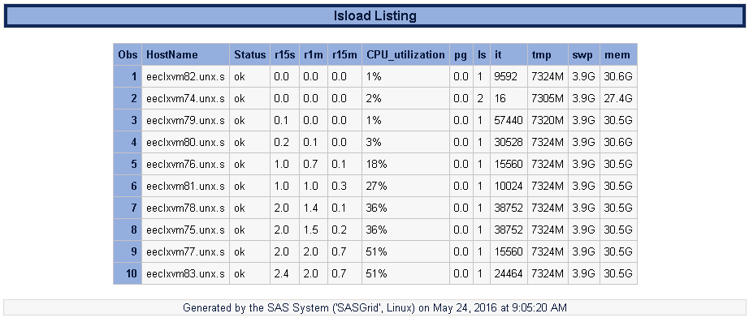
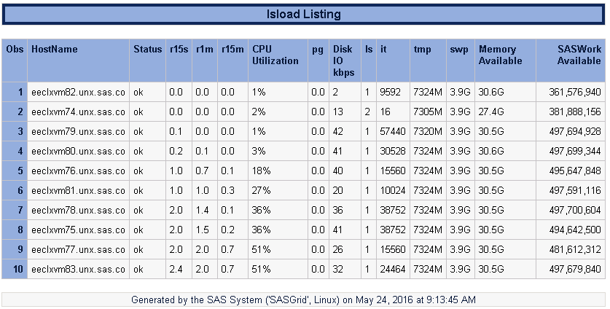
Notes:
%lsload and %lsloadl shows all Grid resources, notice the lsload also shows IO and the “SASWork Diskspace Available” ELIM we created. We can also see that the workloads are cpu intensive but not very IO intensive.

Slide 25
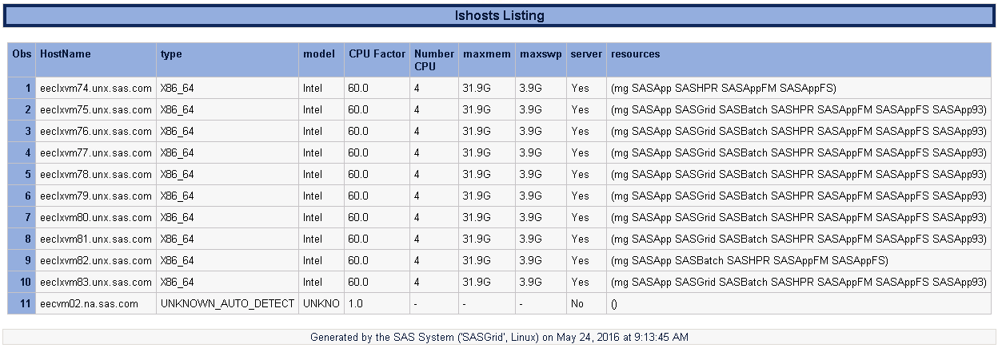
Notes:
%lshosts

Slide 26
SASGSUB - SAS Admin Role Grid Macros
%bacctq (guser=all, que=normal); /* Individual user or all, and a queue */
%bacct (guser=all); /* Individual user or all, and all queues */
%bacct(guser=‘sasdemo sasdbg'); /* note quotes on multi values*/
%bacctq(guser=sasdemo,que='EM_normal EG_normal SS_normal');
Macro call for Grid history summary for user and/or queue for last 3 months.
Provide userid for an individual user or “all” for all users (all is the default).
Provide queue desired (normal is the default).
Notes:
%bacct reports on Grid history summary for user and/or queue

Slide 27
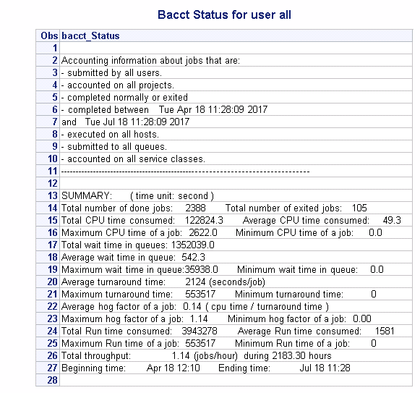
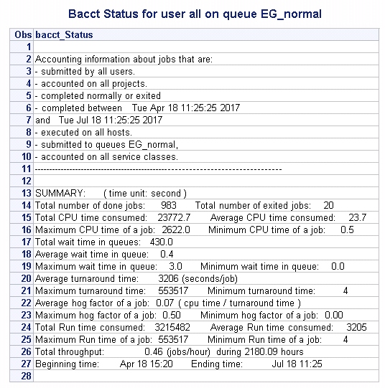
bacct status for users ALL
bacct status for ALL on queue EG_normal
Grid Monitoring with EGuide
Notes:
%bacct reports on Grid history summary for user and/or queue

Slide 28
SASGSUB - SAS Admin Role Grid Macros
%egoshl
%egoshv (service=ServiceDirector);
Provide EGO Service name to report on
Macro call for listing of EGO services

Slide 29
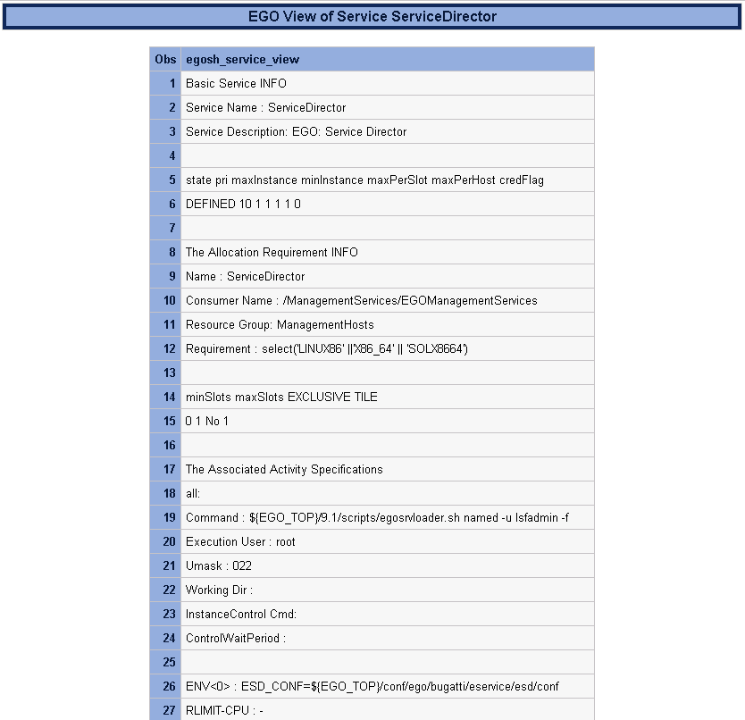
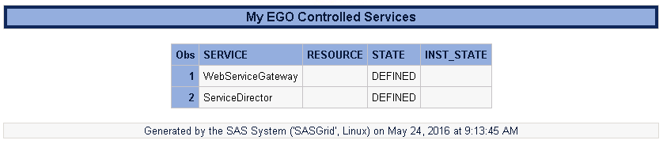
Grid Monitoring with EGuide
Notes:
%mygsub results give jobid, job directory and job log. This example is the default locations of sasgsub to the Gridwork directory.

Slide 30
SASGSUB - SAS Admin Role Grid Macros
Required setup
If you like any of the previous macros then this is what you need to do to make them work in your environment.
Assumes sasgsub has previously been installed/configured on the clustered file system
Copy macros to SAS Grid Shared file system
Edit appserver_autoexec.sas (add macro var for sasgsub config directory)
Validate sasgsub.cfg does not have _prompt_ for metapass
Set up Application Server Context
For file navigation to outputs
For xcmd permissions

Slide 31
SASGSUB Macros - Step 1: Extract zip file
Macros or .sas files should be copied to the following directory:
<SASConfigDir>\Lev1\SASApp\SASEnvironment\SASMacro
Alternatively if you want to provide macros to all Server Context then update
the <SASHOME>/SASFoundation/9.X/sasv9_local.cfg with below
-insert sasautos /sas/DGMacros
(/sas/DGMacros would be where you extract the macros. Any location on the
clustered file system will be fine.

Slide 32
SASGSUB Macros - Step 2: Edit appserver_autoexec.sas
Windows
i.e. C:\SAS\Config\Lev1\SASApp\appserver_autoexec_usermods.sas
Add: %let gsconfigdir=C:\SAS\Config\Lev1\Applications\SASGridManagerClientUtility\9.4;
Unix
i.e. /SAS/Config/Lev1/SASApp/appserver_autoexec_usermods.sas
Add: %let gsconfigdir=/SAS/Config/Lev1/Applications/SASGridManagerClientUtility/9.4;
Alternatively, if you want to provide macros to all Server Context then create/update
<SASHOME>/SASFoundation/9.4/autoexec.sas
Add: %let gsconfigdir=/SAS/Config/Lev1/Applications/SASGridManagerClientUtility/9.4;
The &gsconfigdir value should be the location of the sasgsub command:
Windows: sasgsub.cmd
Unix: sasgsub

Slide 33
SASGSUB Macros - Step 3:
Validate sasgsub.cfg does not have _prompt_ for metapass
Because we are using the xcmd, there cannot be any interactive windows popping up. The _prompt_ value for metapass would cause an interactive window to activate which we cannot interact with.
Open <SASConfgDir>/Lev1/Applications/SASGridManagerClientUtility/9.3/sasgsub.cfg
Navigate to Metauser and Metapass value
Enter a valid metadata user and password:
i.e.
-METAUSER sasgsub@saspw
-METAPASS {SAS002}1D57933958C580064BD3DCA81A33DFB2
or comment out:
/*-METAUSER sasgsub@saspw */ /* metadata server will honor session users authentication */
/*-METAPASS _prompt_ */

Slide 34
SASGSUB Macros - Step 4 a)
Set up Application Server Context - file Navigation
Because users may need to edit or create sas code, we want the file navigation to be set for locations the user can access.
In SAS Management Console
Expand Server Manager, SASApp, SASApp – Logical Workspace Server
Right Click SASApp - Workspace Server and Select Properties
Click the Options Tab
Click on the Advanced Options button
Click the File Navigation Tab and Click the Path radio button
Enter the desired start path, i.e. C:\sas\pgms or /sas/pgms. This location must exist on the compute tier.

Slide 35
SASGSUB Macros - Step 4 b)
Set up Application Server Context – XCMD Permissions
Because these macros need the xcmd capabilities, it must be enabled.
In SAS Management Console
Expand Server Manager, SASApp, SASApp – Logical Workspace Server
Right Click SASApp - Workspace Server and Select Properties
Click the Options Tab
Click on the Advanced Options button
Click the Launch Properties Tab
Check the Allow XCMD box
This requires refreshing spawner(s) or bouncing the object spawner(s)

Slide 36
Resources
SASGSUB Overview
SASGSUB commands
SASGSUB Syntax

